Slide 1
High Pass Filter

Slide 2
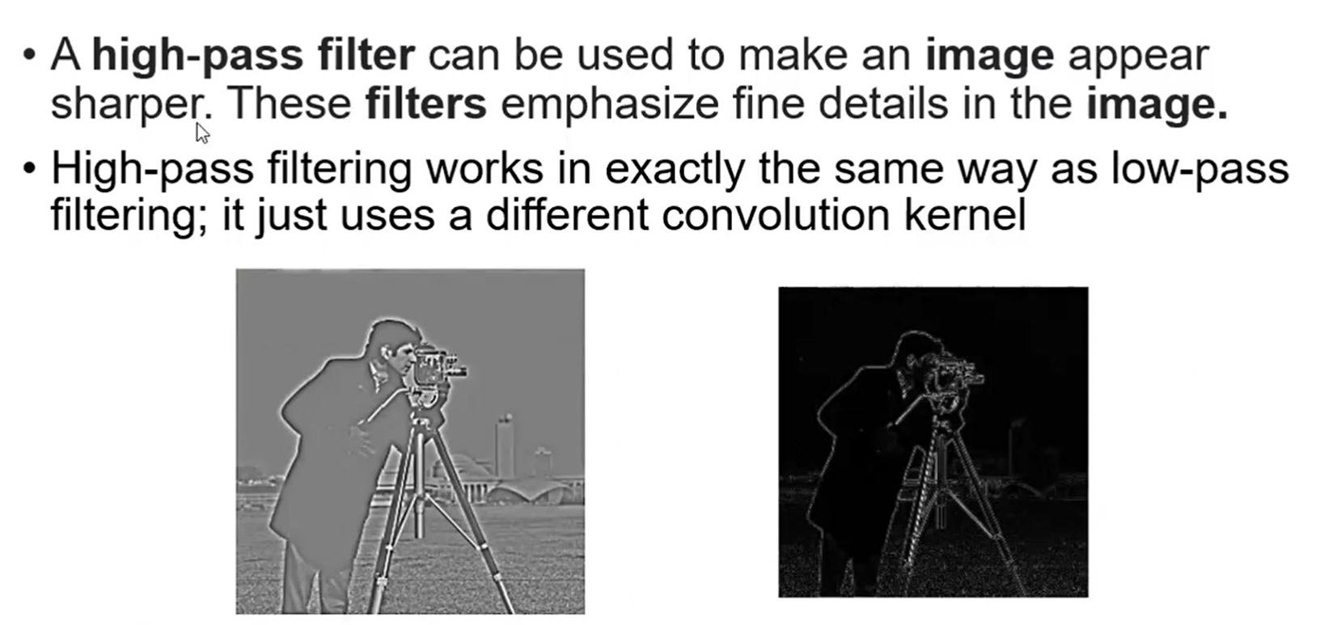
High Pass Filter
Notes:
Frequency in Images:
In image processing, the term frequency refers to the rate at which pixel intensity values change across an image.
Low-frequency components correspond to smooth, gradual changes (e.g., large, uniform regions like the sky or walls).
High-frequency components correspond to rapid intensity changes (e.g., edges, fine details, and sharp transitions).

Slide 3
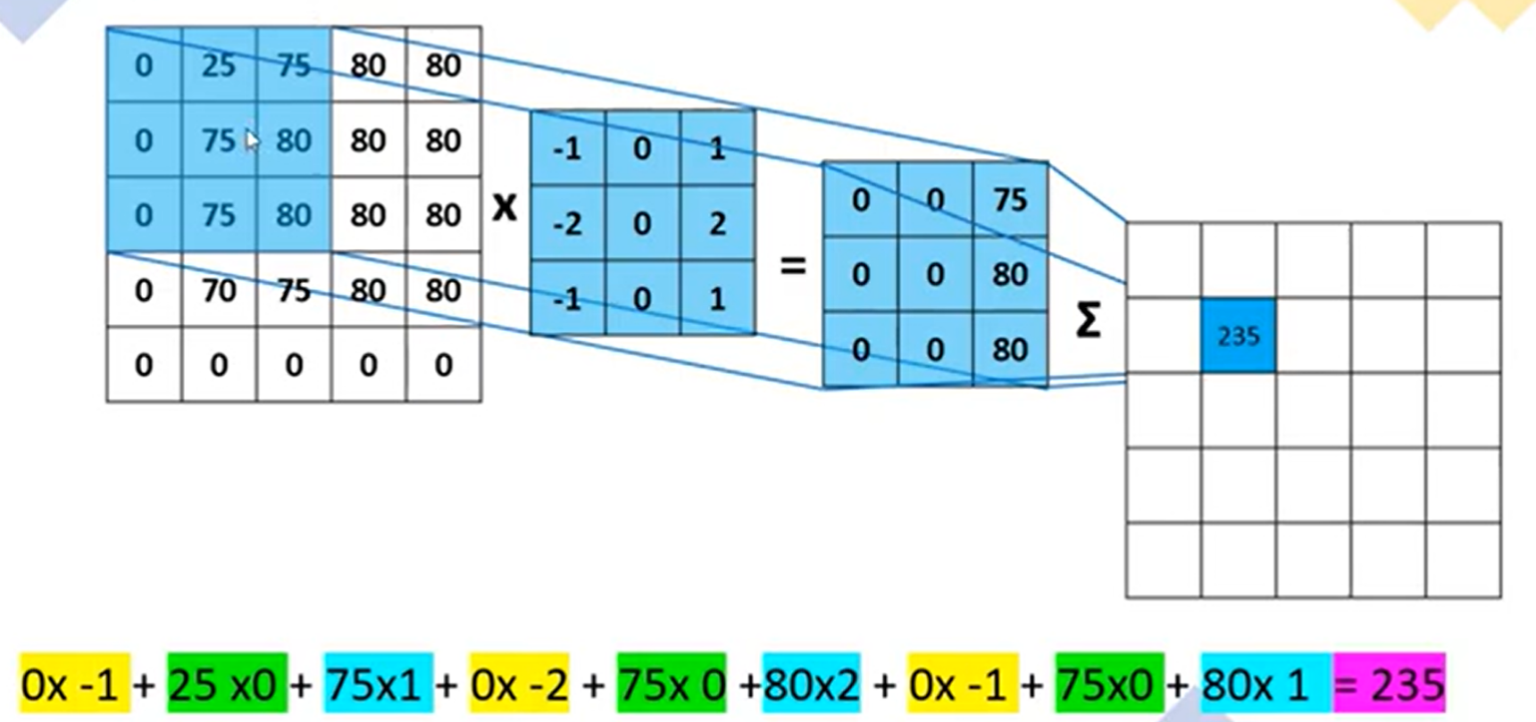

Slide 4
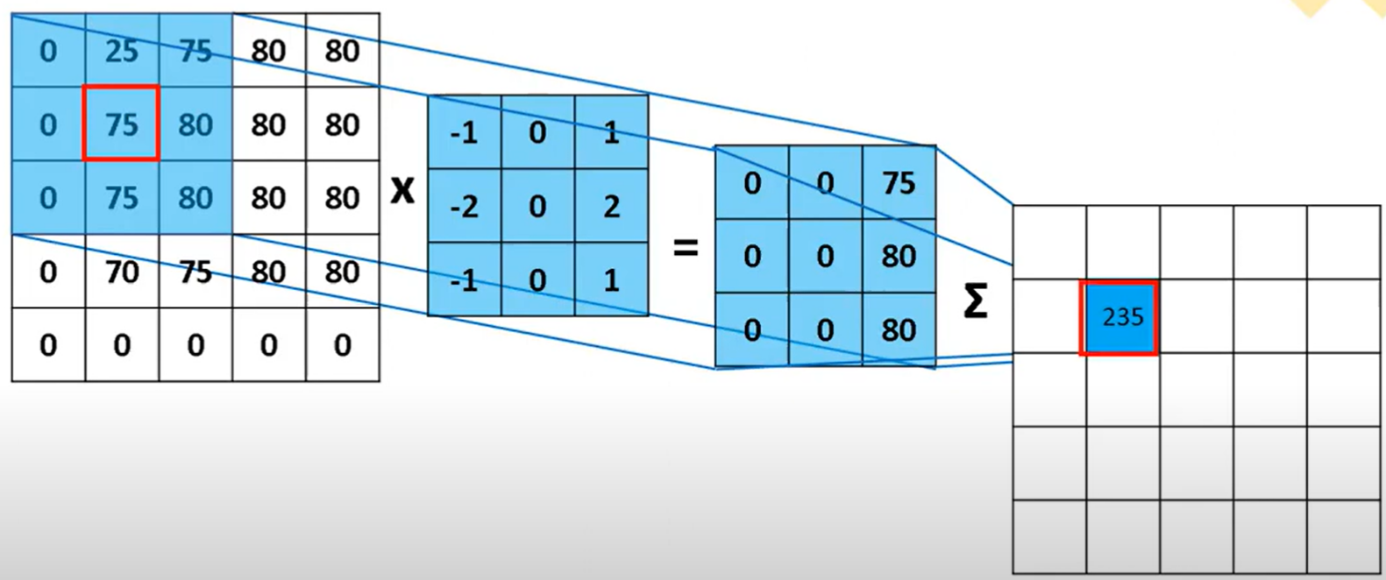

Slide 5
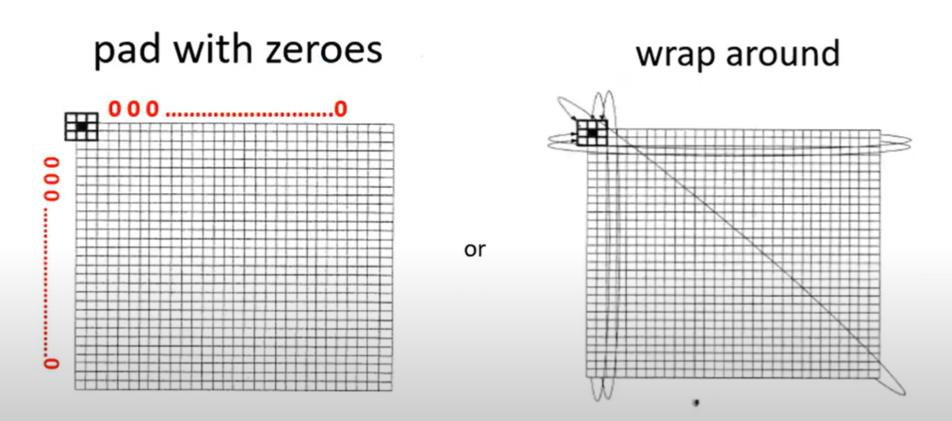
Handling Pixels close to boundaries

Slide 6
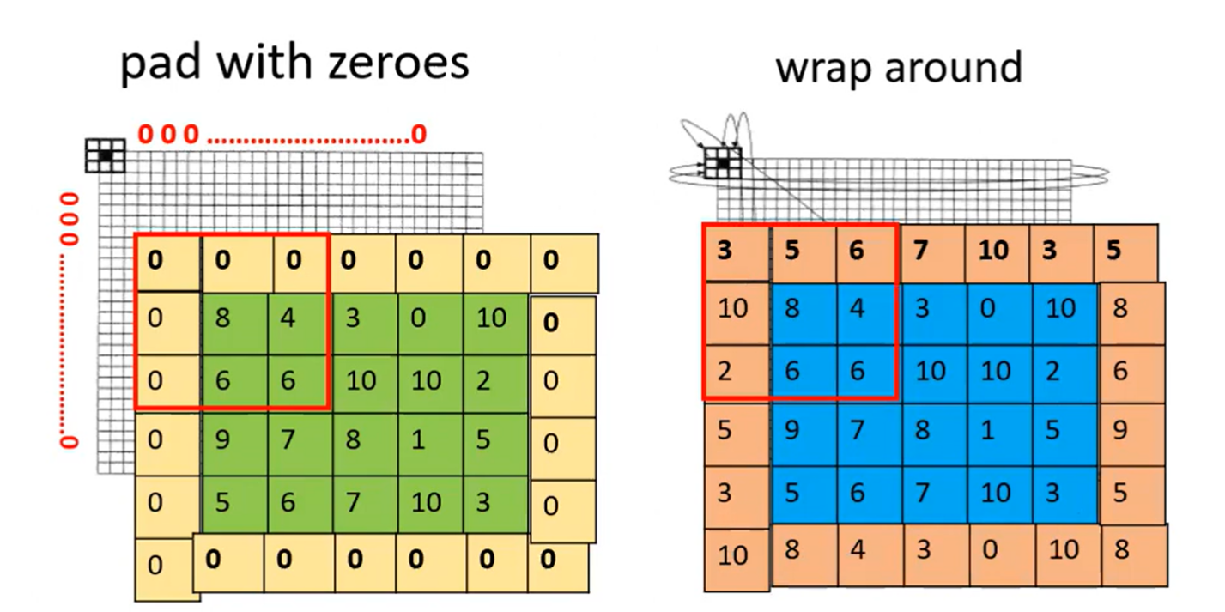

Slide 7
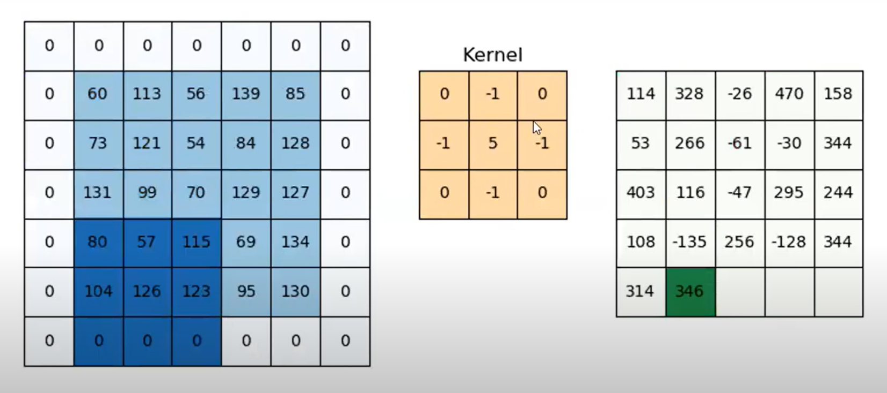

Slide 8
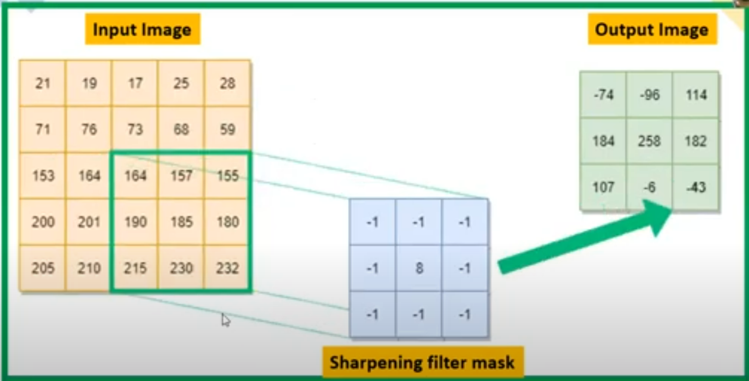

Slide 9
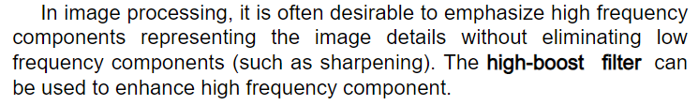

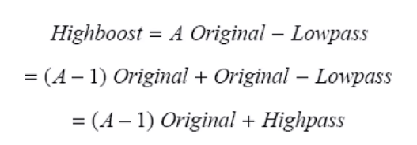
High Boost Filter
Notes:
Function: The high-boost filter is designed to amplify the original image in combination with its high-pass filtered version. This allows the filter to not only boost high-frequency components (like in a high-pass filter) but also retain or even enhance the low-frequency components. The result is a sharpened image that preserves smooth details.

Slide 10
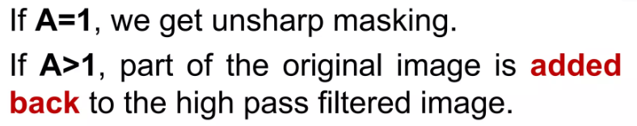
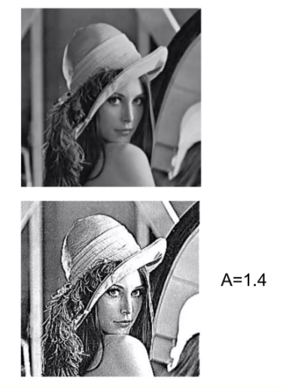
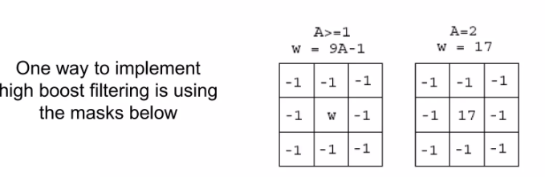
kernel_size = kernel.shape[0]
padding = kernel_size // 2
# Pad the image with zeros
padded_image = np.pad(image, ((padding, padding), (padding, padding), (0, 0)), mode='constant', constant_values=0)

